Slide 1
Design of Reflection Microscopy with different lenses as objective lens

Slide 2
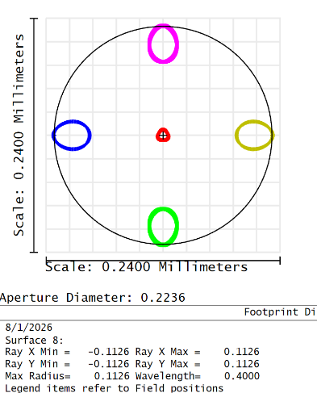
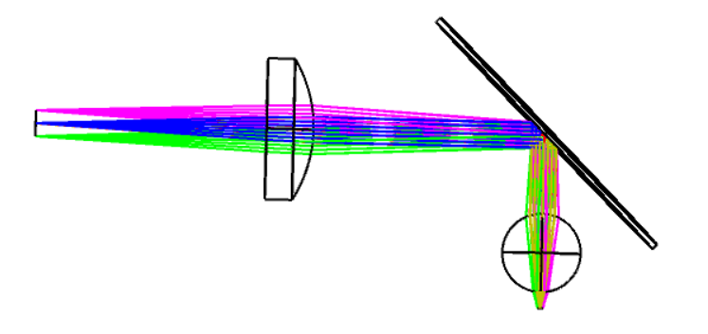
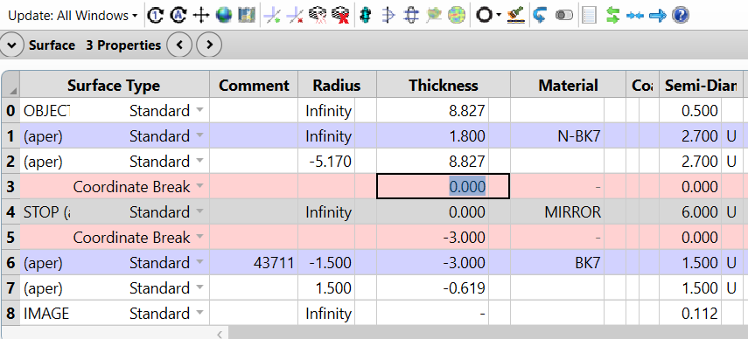
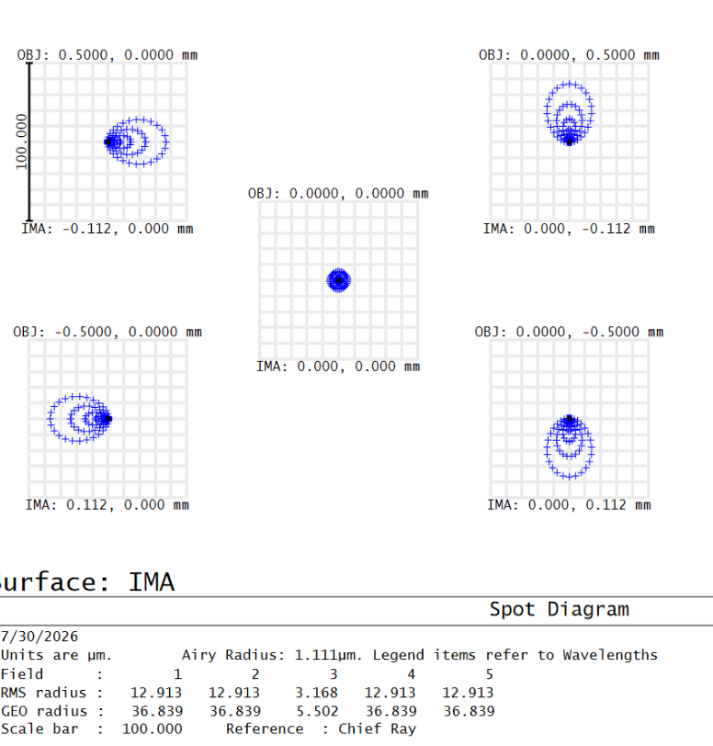
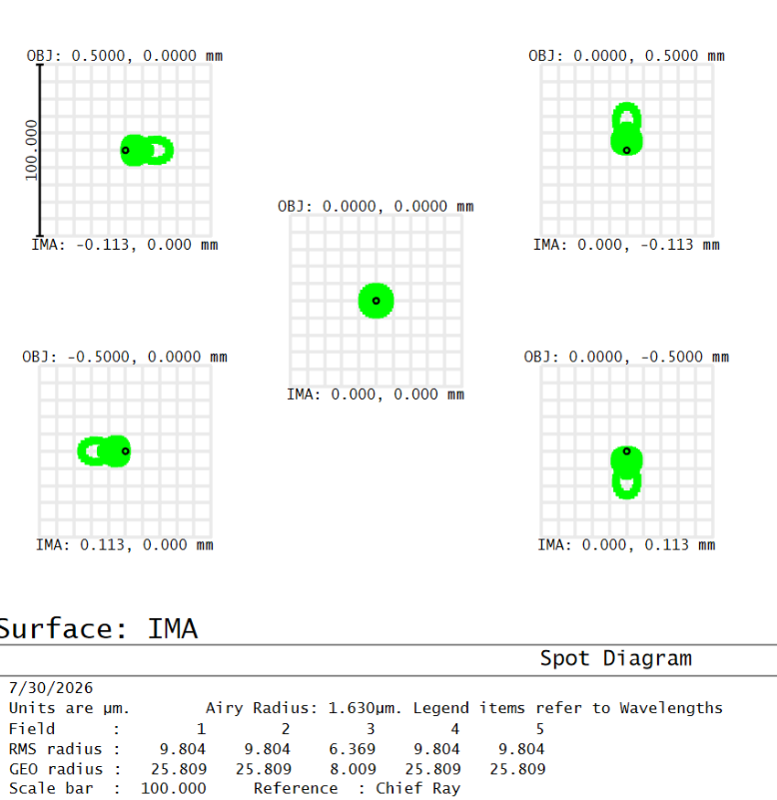
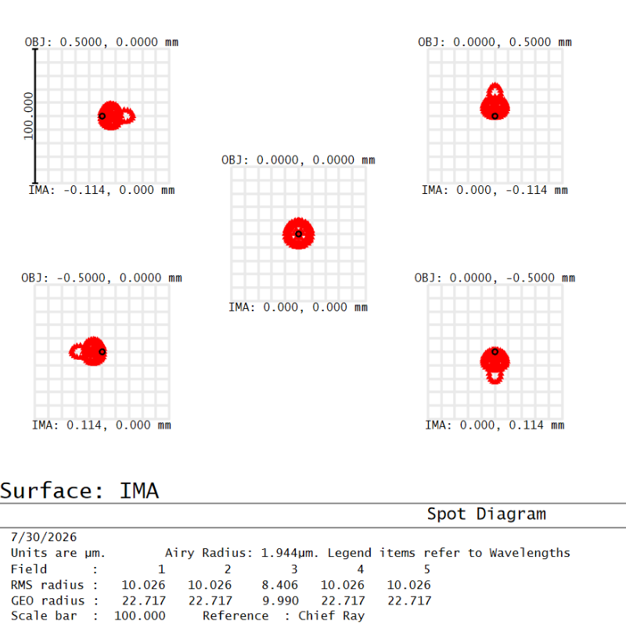
Design with Ball Lens as objective
Fig (a) 2D Layout
Fig (b) Lens Data Editor
Fig (f) Footprint diagram
Fig: Spot diagram of wavelength (c) 400 nm (d) 587 nm (e) 700 nm

Slide 3
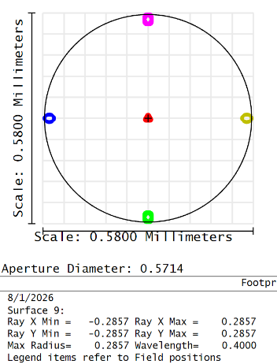
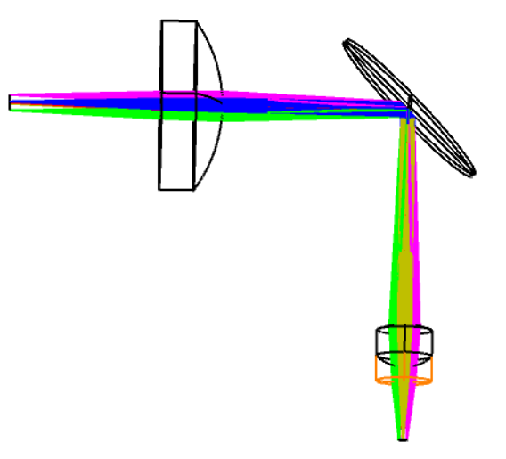
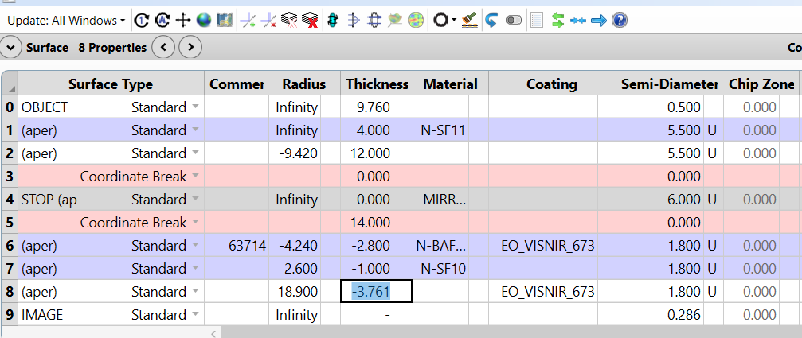
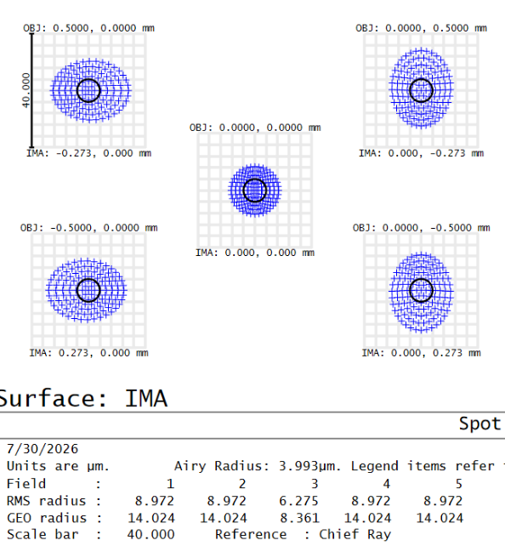
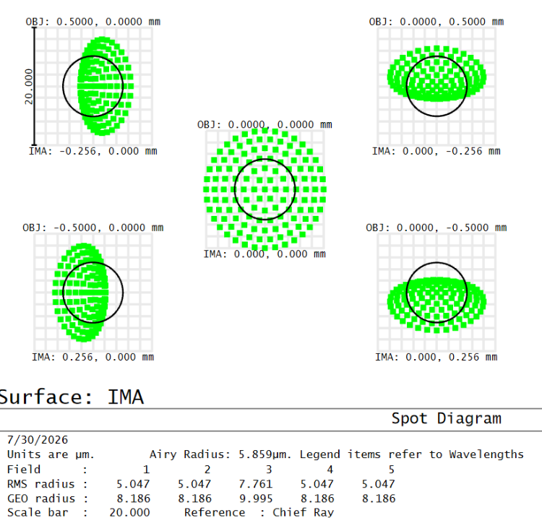
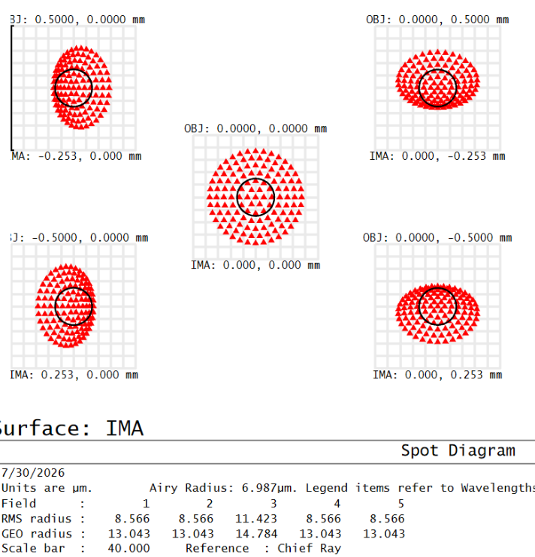
Design with Achromatic Lens
Fig (a) 2D Layout
Fig (b) Lens Data Editor
Fig (f) Footprint diagram
Fig: Spot diagram of wavelength (c) 400 nm (d) 587 nm (e) 700 nm

Slide 4
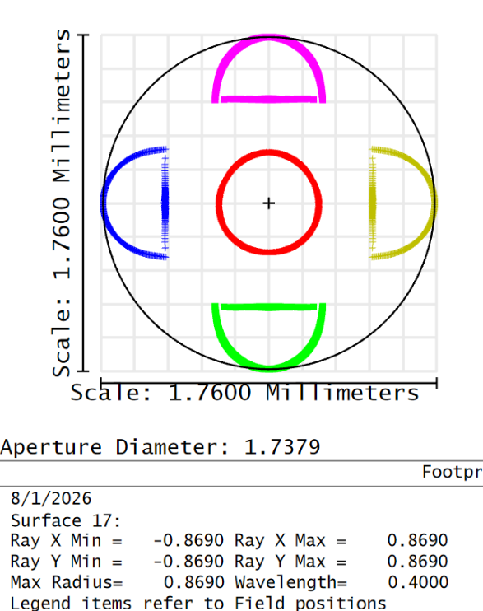
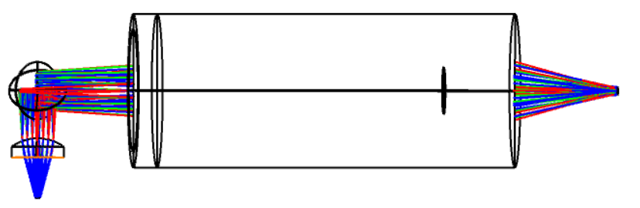
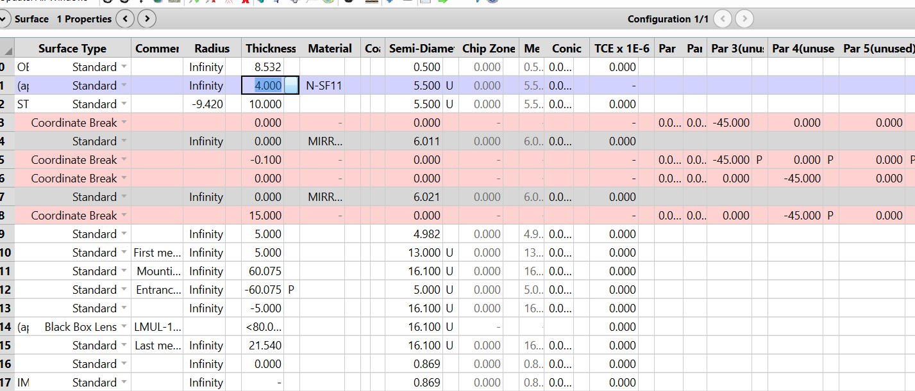
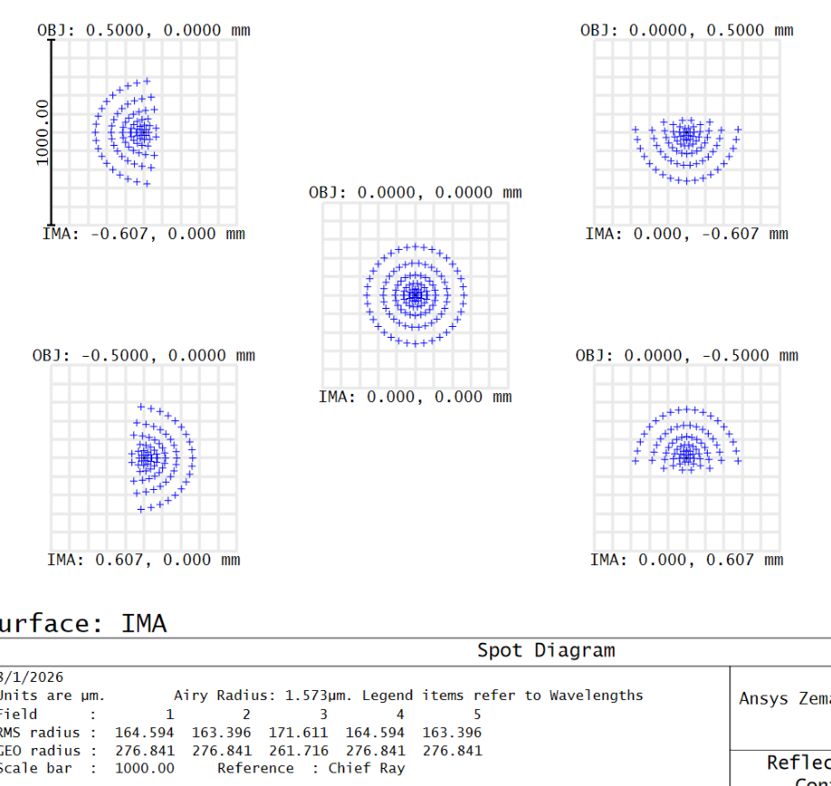
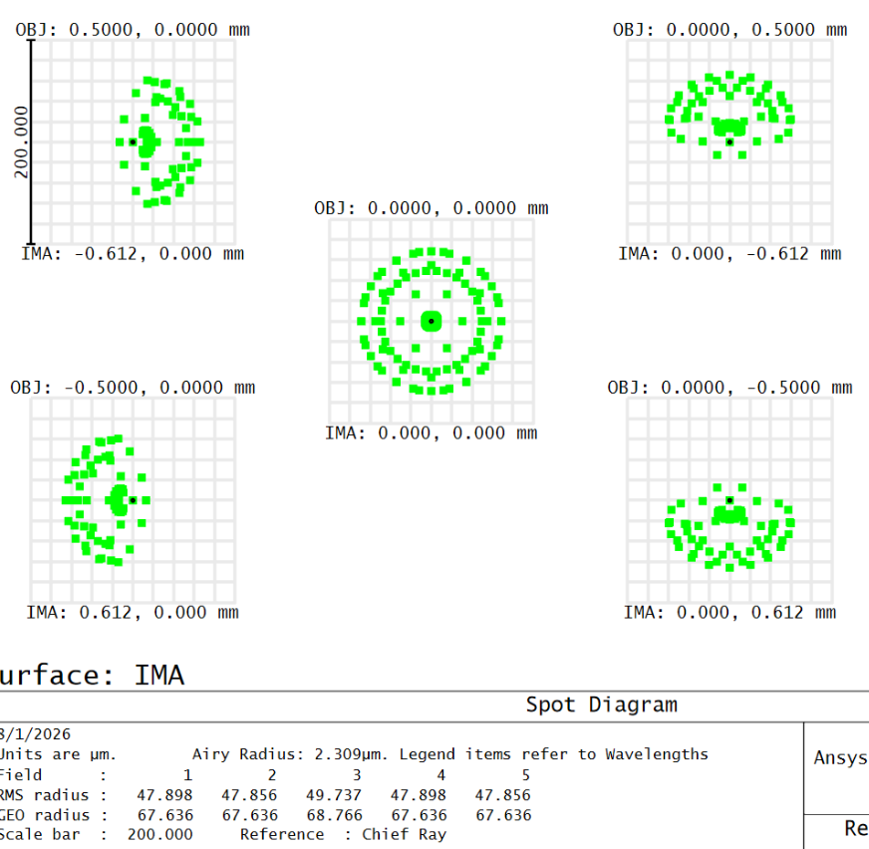
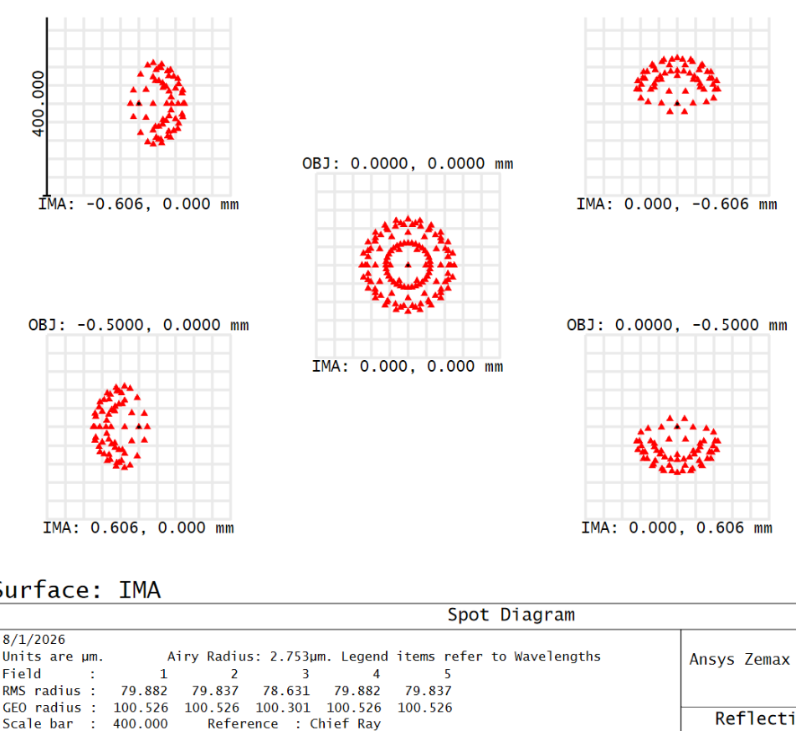
Design with Microscopic objective
Fig (a) 2D Layout
Fig (b) Lens Data Editor
Fig (f) Footprint diagram
Fig: Spot diagram of wavelength (c) 400 nm (d) 587 nm (e) 700 nm

Slide 5
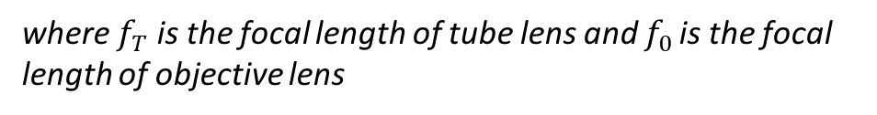

Comment
Magnification of system using ball lens as objective lens
M(total) = M1 × M2
M1 = 1000 (n −1) n/D is the magnification obtained from the ball lens where n is the refractive
index and D is the diameter of the ball lens and M2 = 1 + d /f is the magnification due to the PCX lens used.
M(total) = 171x
2. Magnification of system using achromatic lens as objective lens
$$M=\frac{f_{T}}{f_{0}}= \frac{11}{6 }=1.83x,$$
where $f_{T}$ is the focal length of tube lens and $f_{0 }$is the focal length of objective lens

